Slide 1
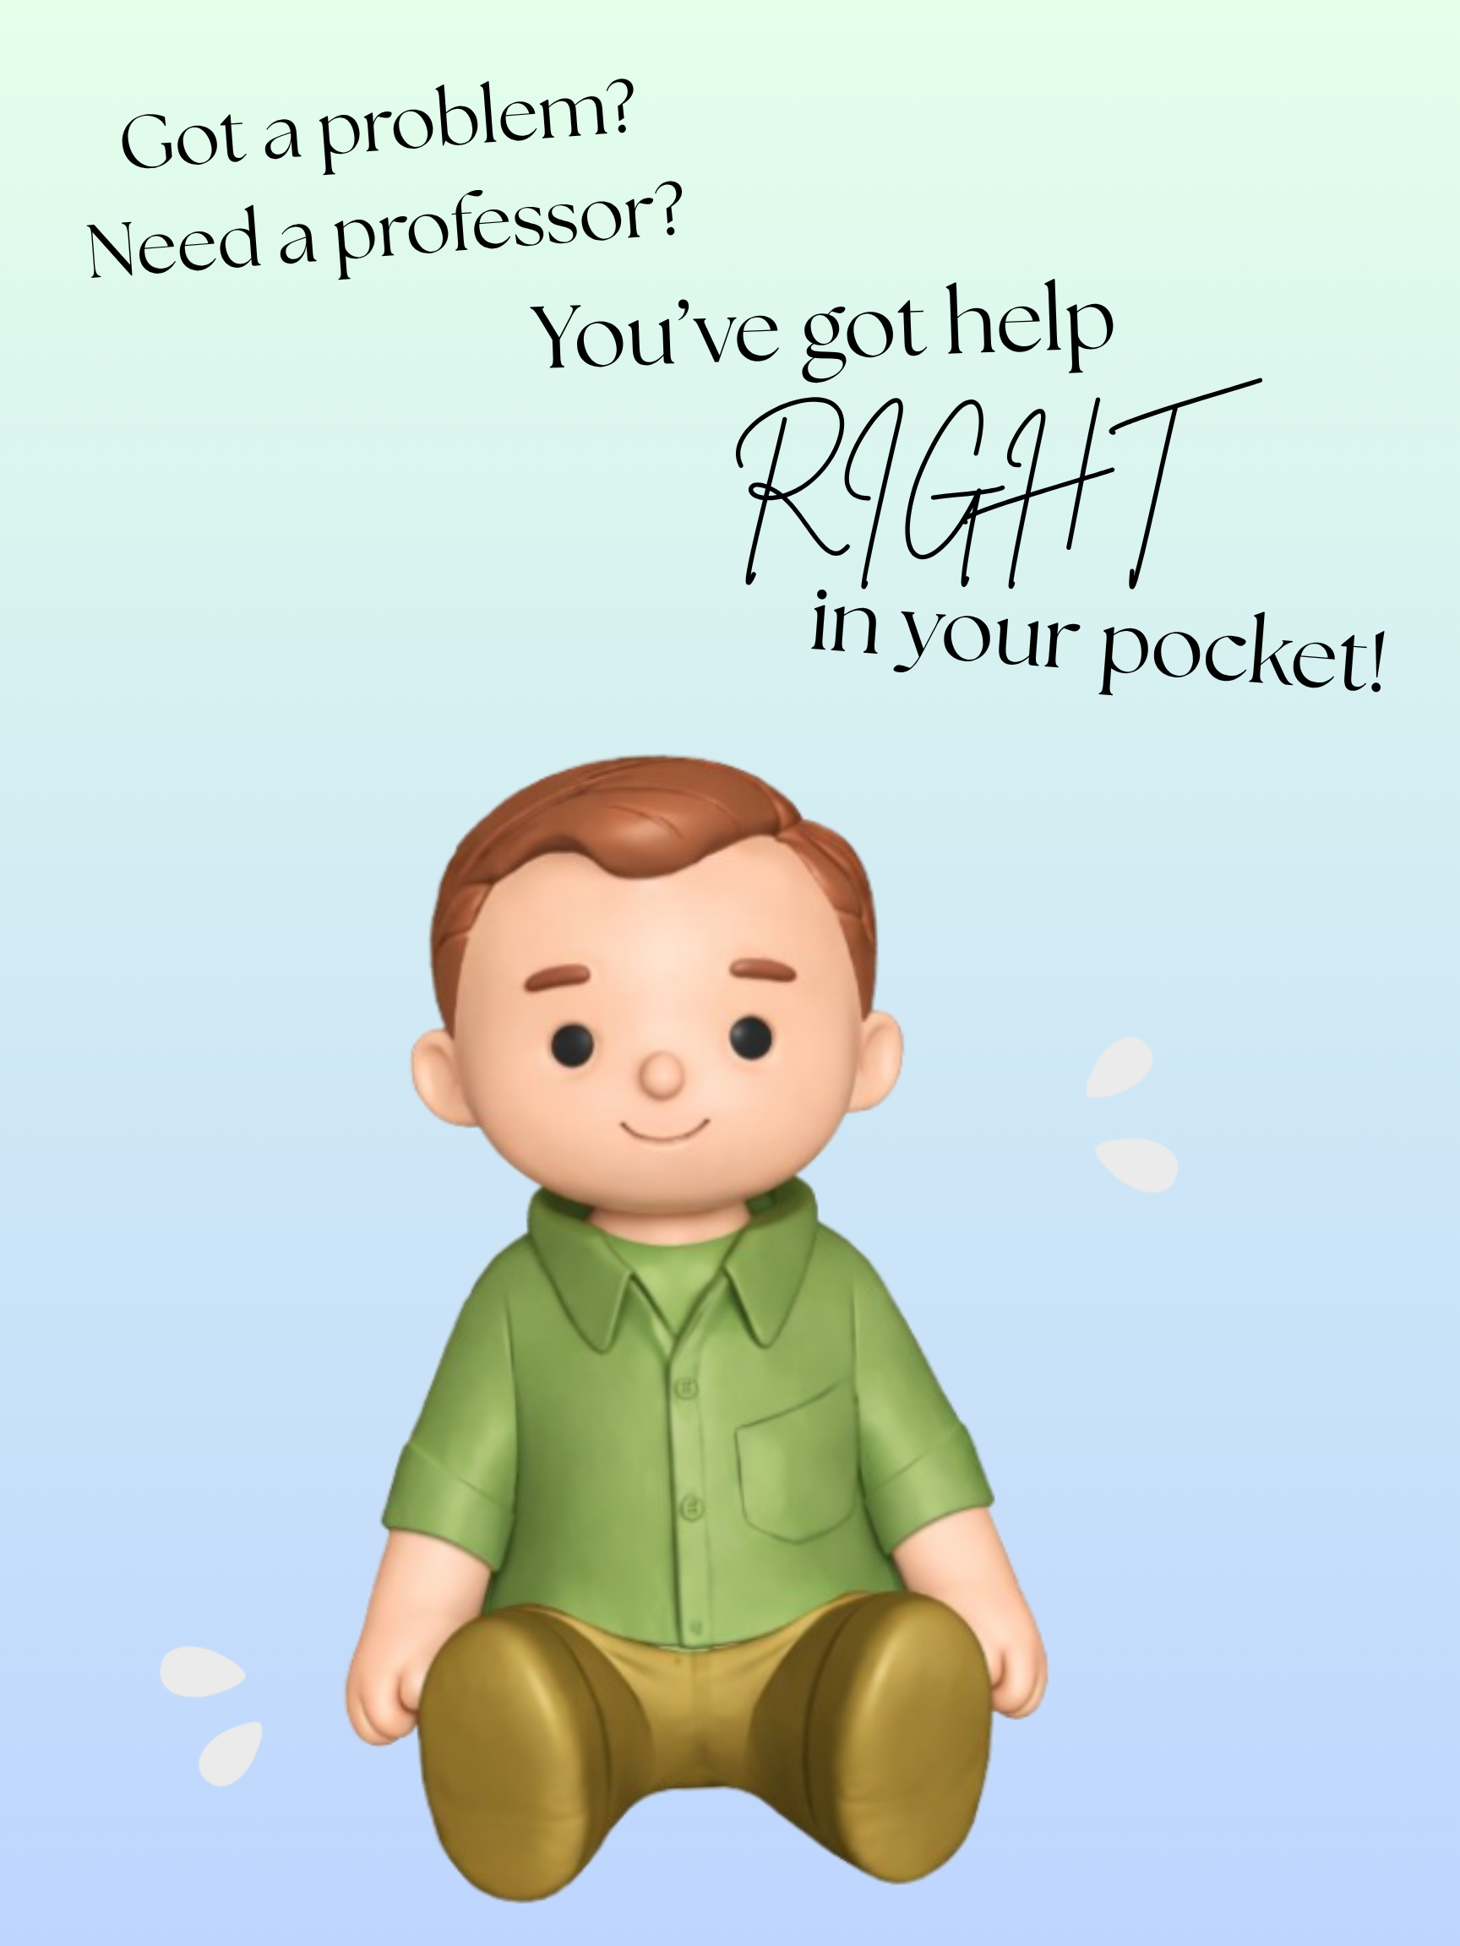
The Pocket Professor
Saige Gee, Lukas Gairdner, Bekah Vanderzee

Slide 2
Agenda
Introduction
Project Overview
Original vs Final Scope
Technology Used
Challenges
Lessons Learned
Conclusion

Slide 3
Team Introduction
Name: Saige Gee
Role: 3D-Printing the Pocket Professor and Code help
Name: Lukas Gairdner
Role: Coding & Hardware Setup
Name: Bekah Vanderzee
Role: Code Help and Documentation

Slide 4
Project Overview
The Pocket Professor is a small physical IT assistant designed to help users troubleshoot problems without needing to stop what they’re doing.
It uses a Raspberry Pi combined with open-source AI, along with a camera and microphone to understand both voice input and the user’s workspace.
Instead of giving full answers, it provides hints to guide the user toward solving the problem themselves.
The main goal is to keep users focused and avoid distractions like phones or searching online.

Slide 5
Original Scope
Physical IT assistant model
Camera-based workspace viewing
Voice Interaction
Hint-Based AI responses
Face-down detection

Slide 6
Final Scope
Physical 11 inch model
Raspberry Pi + AI
Hint-based responses
Face-down detection removed for hardware safety and time constraints

Slide 7
Technology Stack
Raspberry Pi 5
Python (3.11+)
Speech-to-Text + Text-to-Speech
Open-Source AI model
Camera + Microphone + Speaker
Why These Technologies?
Low cost
Runs locally
Flexible with Python
Supports hardware integration
Easily portable

Slide 8
Good Parts (Strengths)
Functional working prototype
Successful hardware integration (Camera, audio, AI)
Hand-free interaction achieved
Team adapted to setbacks
Improved workflow overtime
Notes:
Despite some challenges, there were several strong outcomes from our project.
We successfully built a functional prototype that met our core goal of providing hands-free IT assistance.
We were able to integrate multiple components, including the camera, microphone, speaker, and AI system, into a single working device.
Another positive was our ability to adapt to setbacks. For example, after the 3D printing issue, we adjusted our approach and continued progressing.
Over time, our workflow and coordination also improved as we recognized and addressed earlier communication issues.

Slide 9
Challenges
Communication gaps within team
Limited use of GitHub and Git
Time management challenges
3D printing redesign caused significant delays
Notes:
One of our main challenges was communication within the team. At times, we didn’t consistently share progress or updates, which led to confusion and inefficiencies.
We also didn’t fully utilize tools like GitHub for collaboration and version control, which made it harder to track changes and stay organized.
In addition, balancing this project with other coursework made time management difficult.
A major technical setback occurred during 3D printing, where an early design didn’t account for hardware size, leading to a full reprint that took over 50 hours.

Slide 10
Lessons Learned
Importance of consistent communication
Use of collaboration tools (Github) effectively
Plan and verify before printing
Strong time management is crucial
Notes:
This project highlighted how important consistent communication is in a team environment. Even small gaps can lead to larger issues later on.
We also learned that tools like GitHub are essential for managing collaboration, tracking progress, and avoiding confusion.
Another key takeaway was the importance of planning and verifying designs before committing to time-intensive tasks like 3D printing.
Finally, we learned that strong time management is critical when balancing multiple responsibilities.

Slide 11
Conclusion
Successfully built functional prototype
Achieved core goals
Valuable technical + teamwork experience
Future improvements possible
Key lessons in communication and Planning
Notes:
In conclusion, our team successfully developed a functional Pocket Professor prototype that meets our core objective of providing hands-free IT assistance.
Throughout the project, we were able to apply both hardware and software concepts to create a working system using a Raspberry Pi, camera, and voice interaction.
While we faced challenges, particularly with communication, time management, and hardware design. These experiences helped us better understand the importance of planning, collaboration, and using the right tools.
Overall, this project gave us valuable real-world experience that goes beyond typical classroom assignments.
If we were to continue developing this project, we would focus on improving performance, refining the design, and strengthening our team workflow from the start.
Thank you for your time, and we’re happy to answer any questions.

